Slide 1
Data Science Process Pipeline to solve employee Attrition and their Job Performance and Predicting With AI (Batch d19)
Vanka hari Janardhan – 16N31A05P9
S Vinay – 16N31A05J6
T Manikanta naga hanuman – 16N31A05N0
Project GUIDE – Mr. T Siva RATNA SAI

Slide 2
Contents
Abstract
Existing System
Proposed System
System Architecture
Steps Performed in the Project
UML Diagrams
Software and Hardware Requirements
Code Execution with Outputs
Future Scope of the Project
Conclusion

Slide 3
ABSTRACT
Employees are the backbone of any organization. Its performance is heavily based on the quality of the employees and retaining them. With employee attrition, organizations are faced with a number of challenges:
Expensive in terms of both money and time to train new employees
Loss of experienced employees
Impact on productivity
Impact on profit

Slide 4
Machine learning is a form of AI that enables a system to learn from data rather than through explicit programming.
A machine learning model is the output generated when you train your machine learning algorithm with data. After training, when you provide a model with an input, you will be given an output.
Machine learning enables models to train on data sets before being deployed. Some machine- learning models are online and continuous. This iterative process of online models leads to an improvement in the types of associations made between data elements.
Due to their complexity and size, these patterns and associations could have easily been overlooked by human observation. After a model has been trained, it can be used in real time to learn from data.
The improvements in accuracy are a result of the training process and automation that are part of machine learning.

Slide 5
EXISTING SYSTEM
Now a day’s data science predictions are used in IT industries, for the improvement in market investment, employee management etc.
Retention of valuable employees within an organization has become an important issue as it is hard to find out the reasons that why employees are leaving an organization and keep them satisfied is a big challenge, for this a report is made to predict the retention of an employee in an organization using the python programming with data science methods.
The main idea of this report is to find out that which valuable employee will leave the company and the features which are affecting him/her to making this decision like salary level, no. of hours spending in week, promotion etc. The application was developed in python programming and are made with the help of data science and machine learning models.

Slide 6
The design criteria and the implementation details are presented in this report.
Machine learning has major challenge called acquisition which is based on different algorithms through which data needs to be processed. It must be processed before providing as input to respective algorithms. Thus it has a significant impact on results to be achieved or obtained.
Interpretation is another backlog that is needed to determine the effectiveness of machine learning algorithms.
The use of machine learning algorithms is limited. It is not having any surety that its algorithms will always work in every case imaginable. In most cases machine learning fails. Thus it requires some understanding of the problem at hand to apply the right algorithm.

Slide 7
PROPOSED SYSTEM
We know that larger companies contain more than thousand employees working for them, so taking care of the needs and satisfaction of each employee is a challenging task to do, it results in valuable and talented employees leave the company without giving the proper reason.
This project provides solution for the given problem as it gives a prediction model that can be used to predict which employee will leave the company and which will not leave.
It also helps in finding the exact reasons which are motivating the employees for shifting companies like lower salary, less promotions or heavy work load etc. To find the result in the form of yes or no.

Slide 8
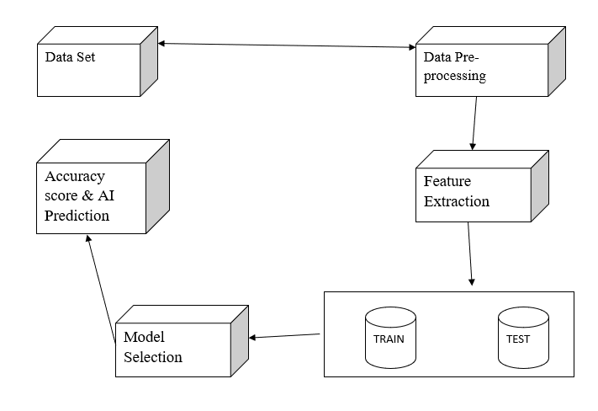
System Architecture

Slide 9
Steps performed in the Project are:
Download Employee Dataset from IBM Website
Read the dataset in Jupyter Notebook in CSV format.
The python program must perform data pre-processing. We must identify the most important attributes of our dataset.
After choosing the most important attributes, we perform various machine learning algorithms.
The algorithm which returns the best accuracy score in the confusion matrix is chosen as our algorithm in the project.
We run the algorithm and the machine is trained and tested using the dataset in a 70-30 manner.
Take input values from end user using command prompt.
Based on the user input given in the command prompt, a prediction is made whether that particular employee is fired or retained.
The result is displayed back on the command prompt.

Slide 10
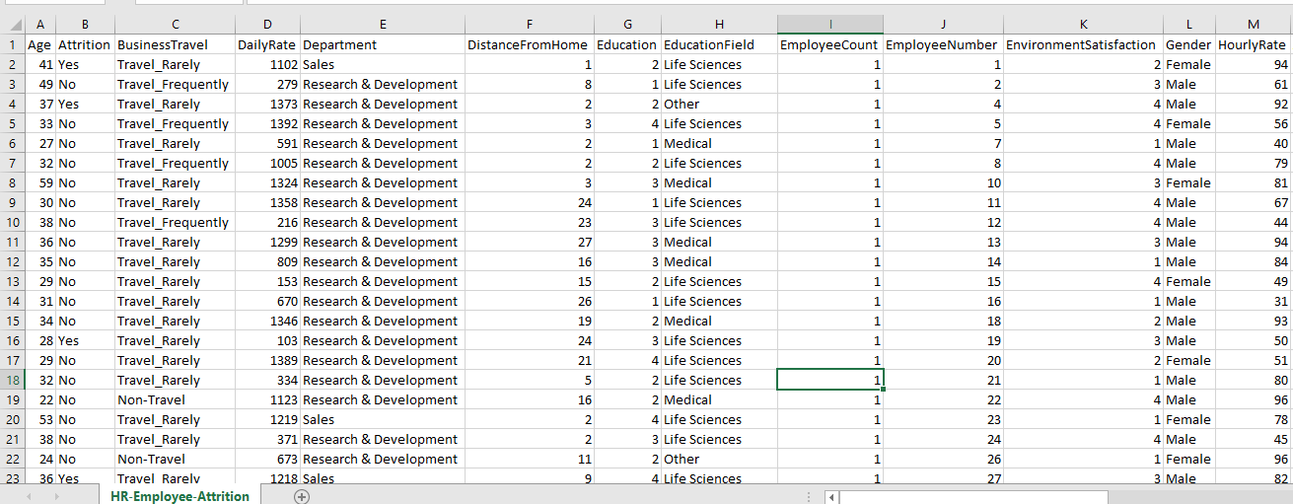

Slide 11
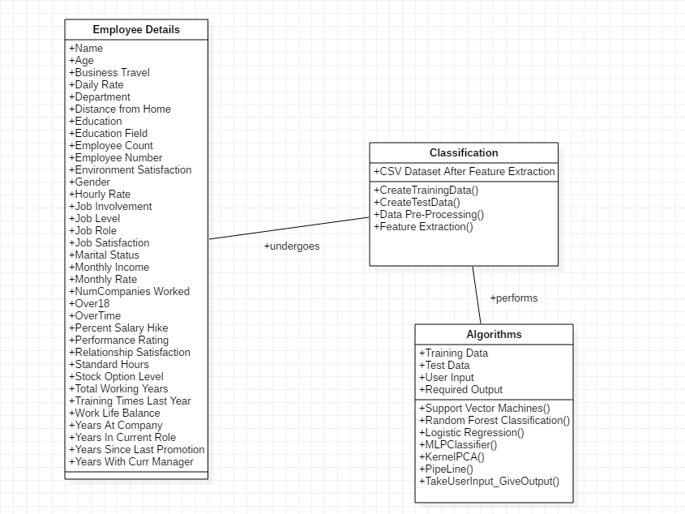
CLASS DIAGRAM

Slide 12
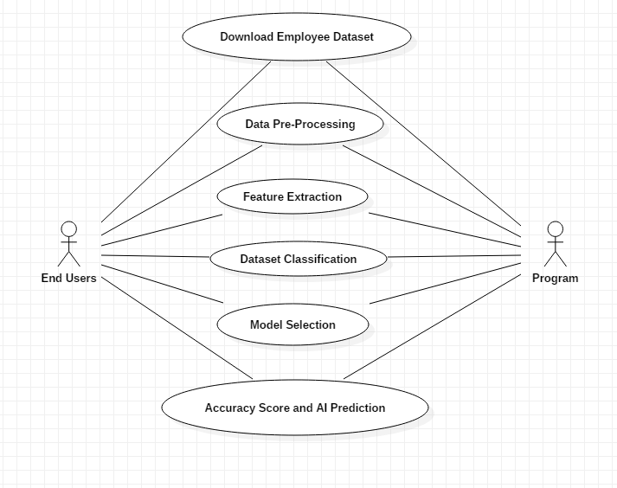
USE-case diagram

Slide 13
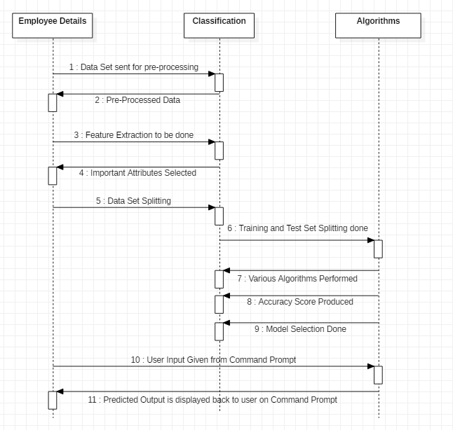
SEQUENCE DIAGRAM

Slide 14
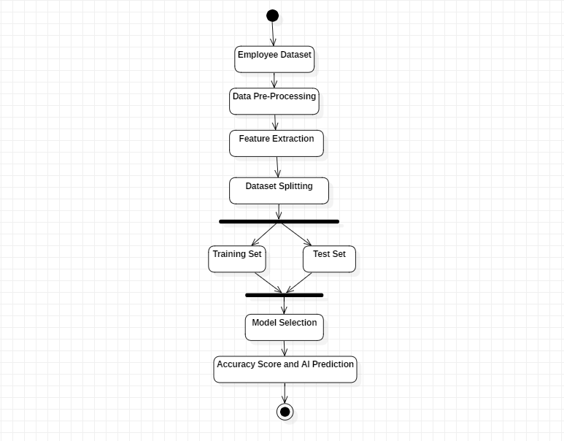
Activity diagram

Slide 15
Software and Hardware Requirements
Hardware: OS – Windows 7, 8 and 10 (32 and 64 bit) RAM – 4GB
Software: Python Anaconda Navigator

Slide 16
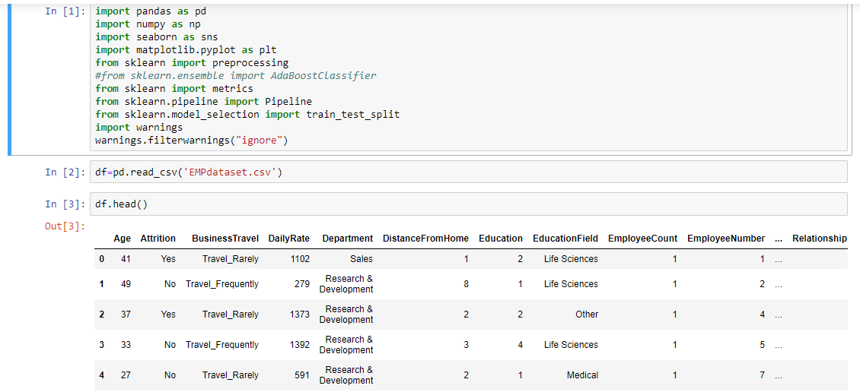

Slide 17
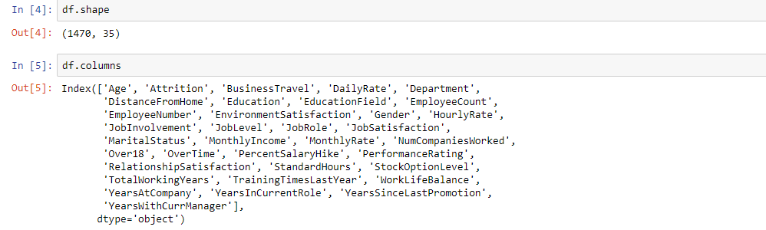

Slide 18
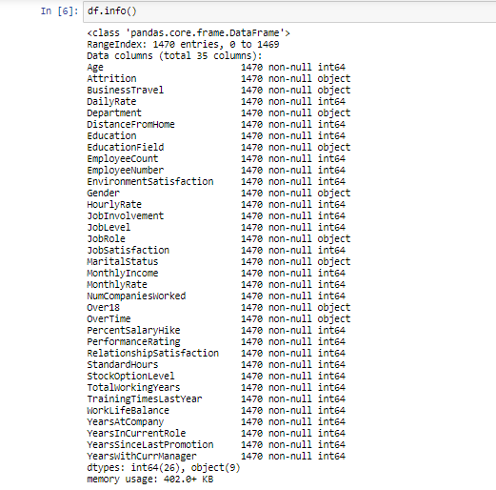

Slide 19
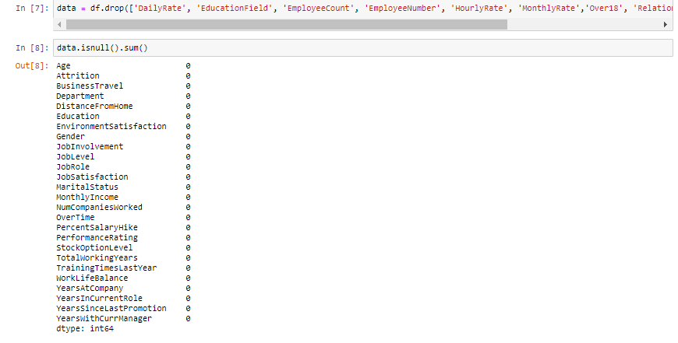

Slide 20
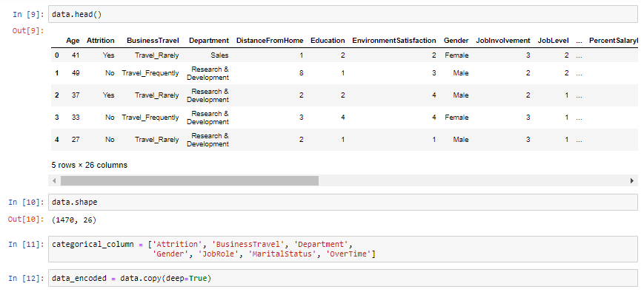

Slide 21
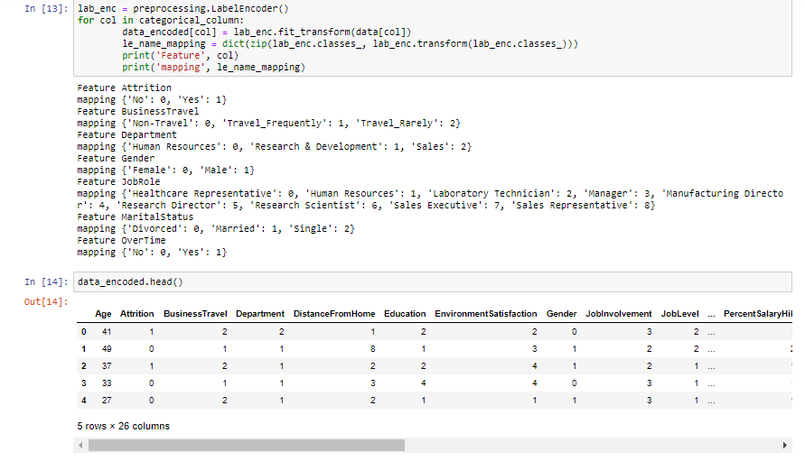

Slide 22
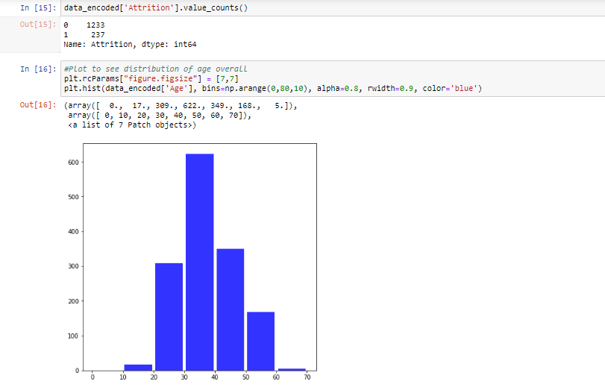

Slide 23
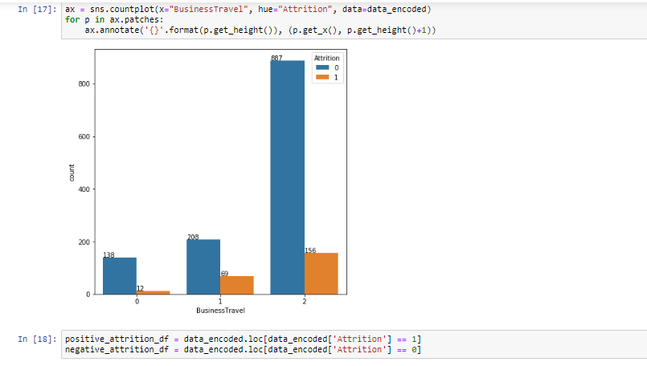

Slide 24
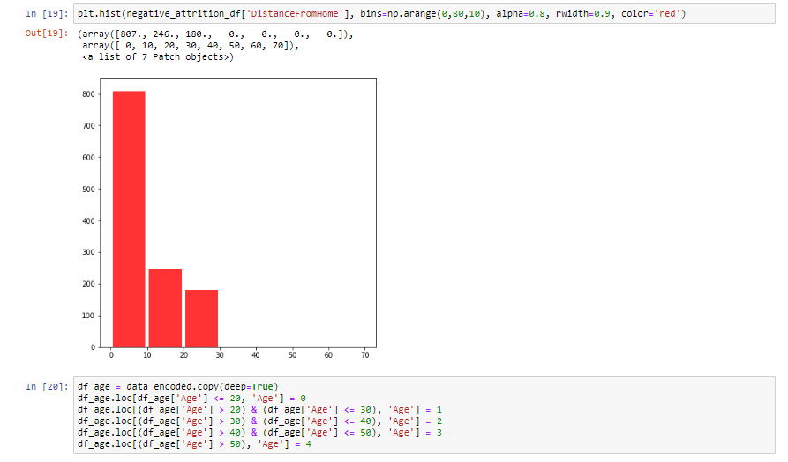

Slide 25
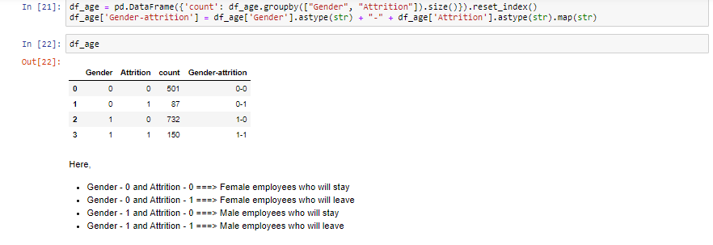

Slide 26
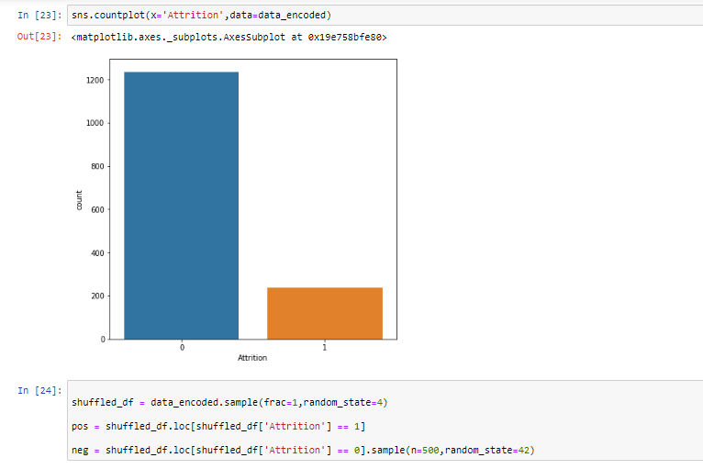

Slide 27
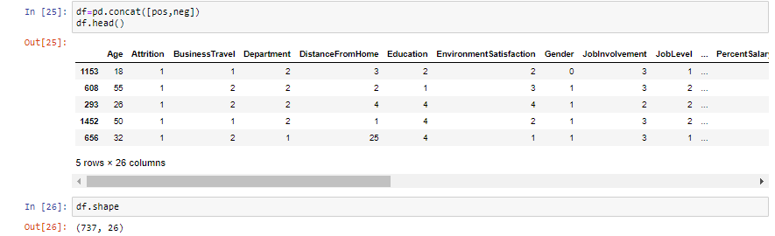

Slide 28
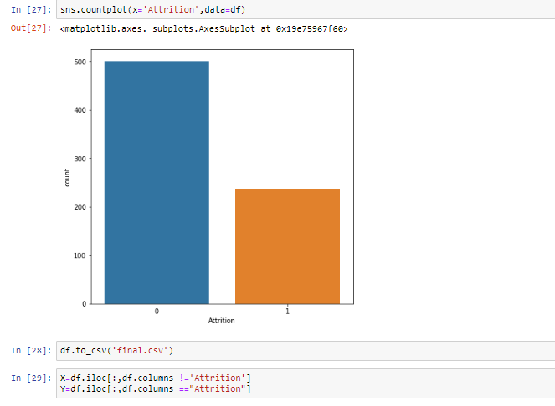

Slide 29
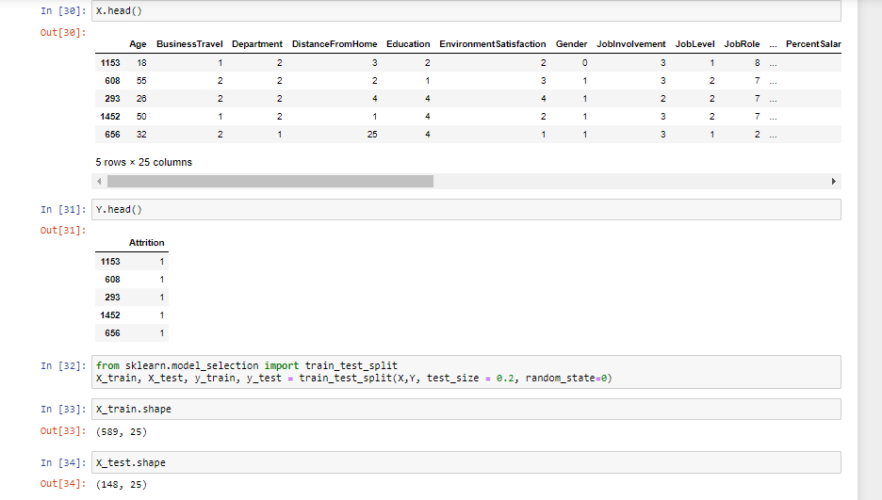

Slide 30
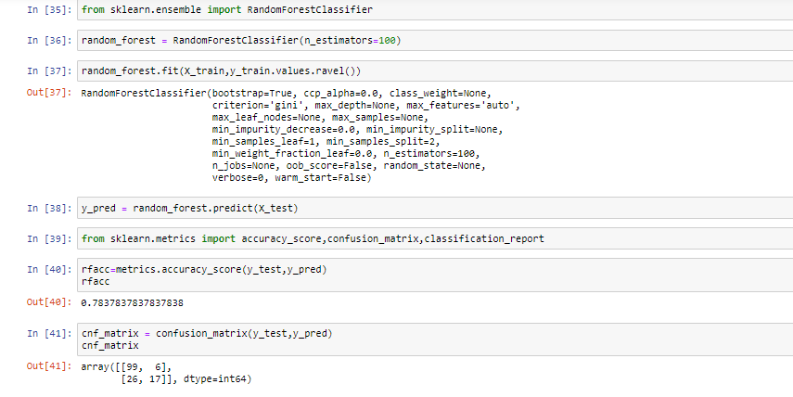

Slide 31
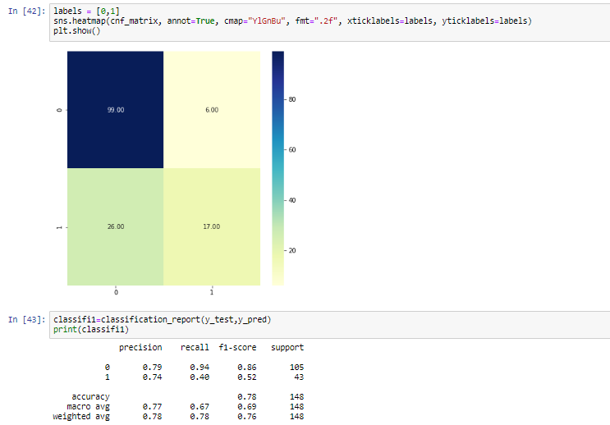

Slide 32
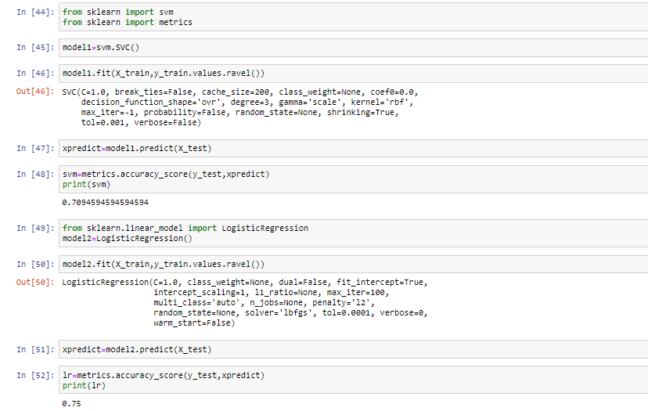

Slide 33
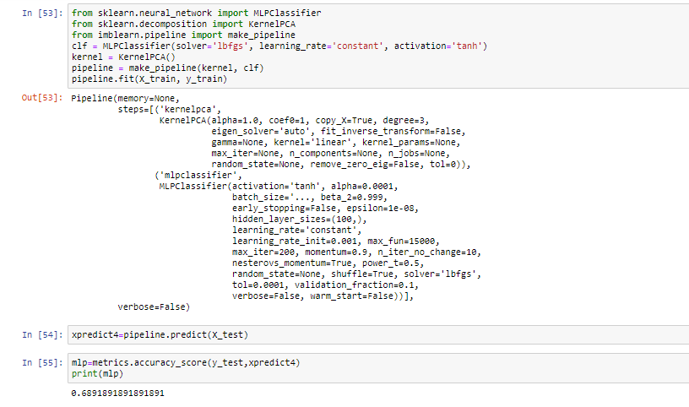

Slide 34
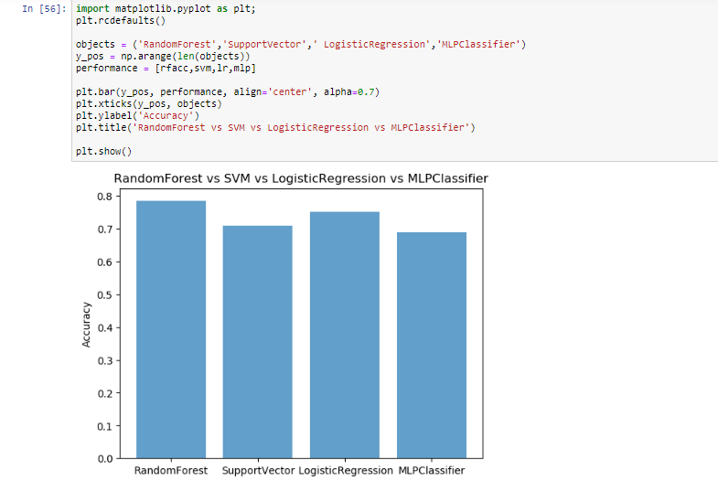

Slide 35
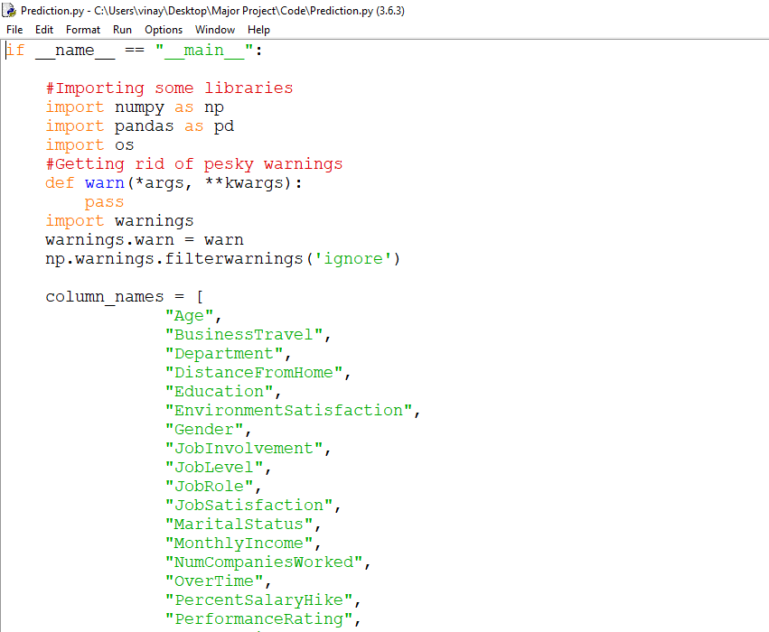

Slide 36
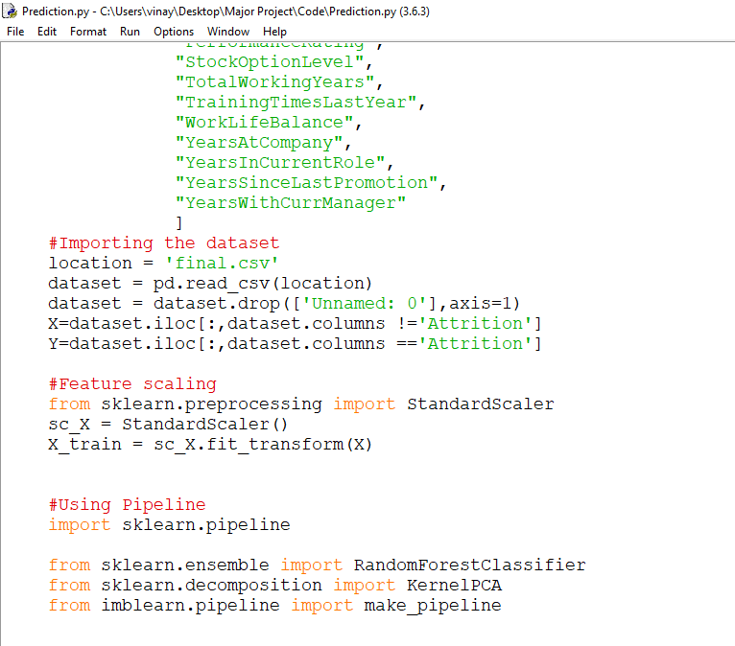

Slide 37
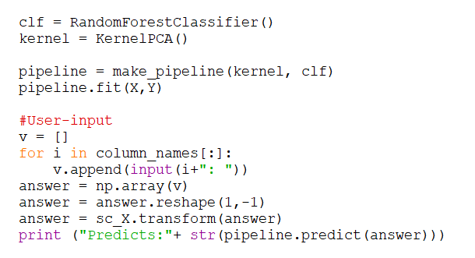

Slide 38
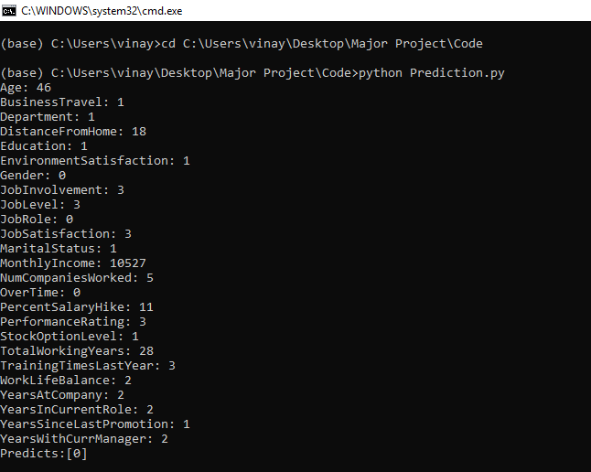

Slide 39
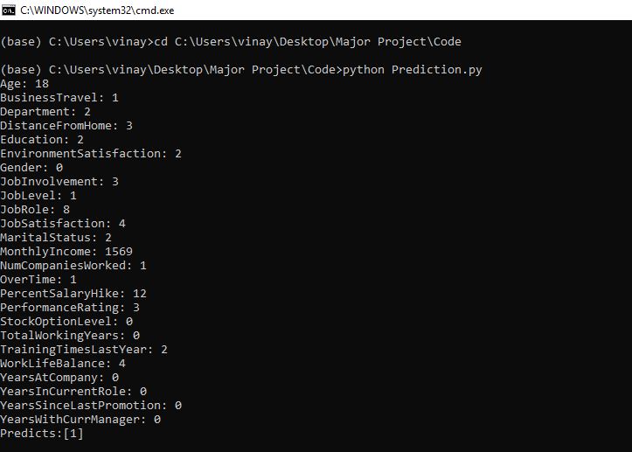

Slide 40
FUTURE SCOPE of the project
AI Fairness 360(AIF), a comprehensive open source toolkit of metrics to check for unwanted bias in datasets and machine learning models. This model eliminates the bias in the dataset.
The model developed will be able to predict whether an employee will stay or not this will help company to know the status of an employee in advance and take necessary actions to prevent loss that will incur.
The findings of the study are subjected to bias and prejudice of the respondent’s time factor can be considered as main limitations the findings of the study are solely depend on the information provided by respondents.
The accuracy of findings is limited by the accuracy of statistical tools used for analysis. Findings of the research may change due to area demography, age condition of economy etc.

Slide 41
conclusion
It can be concluded that the following are the major reasons for employee turnover
Opportunity for growth and promotion outside
Compensation
Working conditions
Work timings/shifts
Relationship with managers
Location of the organisation
Work load

Slide 42


